Slide 1


Product Search Relevance
John Merranko and Katherine Rodgers

Slide 2
Introduction
The purpose of this project is to predict the relevance of search results on HomeDepot.com
Use data processing and advanced text mining techniques
The data consist of search terms (strings of text) and products resulting from each search
Product data include product names, descriptions, and for some products, a collection of attributes
In the training dataset, raters have rated each pair of searches and resulting products on a three-level relevance scale (1 = irrelevant, 2 = partially or somewhat relevant, 3 = perfect match)
The task is to train a model using these data to try and predict the relevance of search and resulting product pairs in the test dataset

Slide 3
Data Processing
We have implemented the initial data processing using Python
We utilize the Natural Language ToolKit, NLTK, to remove non-essential stopwords
We also remove some punctuation within each line of text to get only a series of words
Issues of camel-case scenarios and letter-digit combinations from removal of puncuation were also accounted for
Combined some common measurement values into one representation
We converted all strings of text to lowercase

Slide 4
Data Processing
Due to the fact that any given product could have any number of attributes and the names of attributes are non-uniform among the products, product data can be considered highly unstructured
We decided to simplify the data for each product by collapsing the non-brand-name data in one concatenation per product
Kept the attribute that indicates brand separate from the rest of the data due to its higher relevance as a predictor
For each product, we iterated through all the attributes associated with that product and, aside from “MFG Brand Name”, concatenated relevant info each to the product_description string
Made histograms to give a visual representation of the home depot data

Slide 5
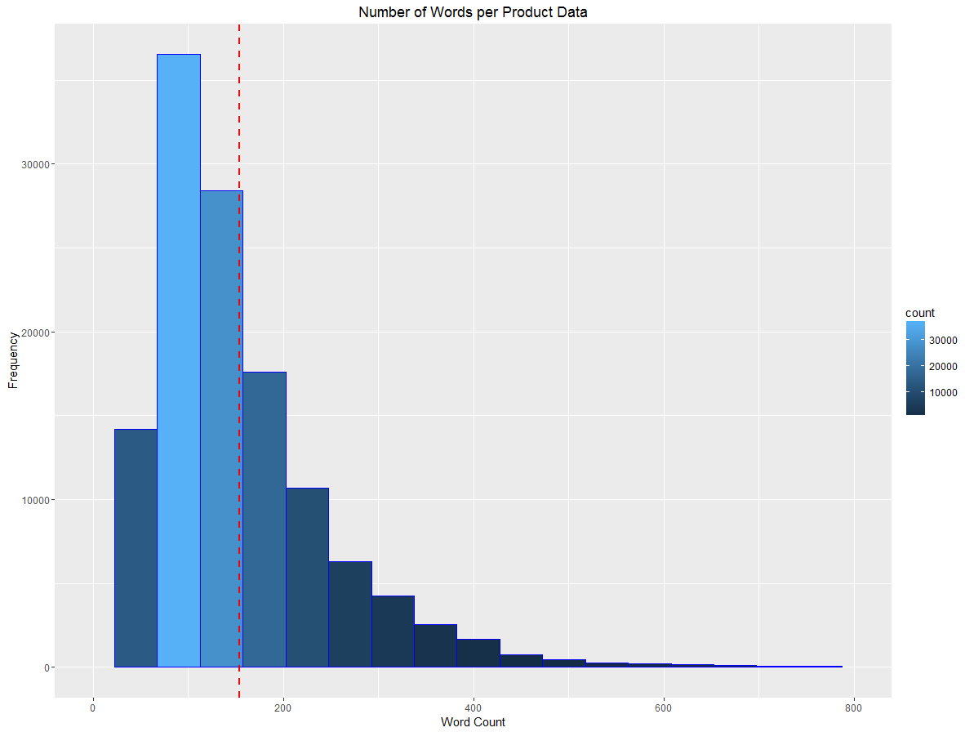
Data Processing
Shows the frequency of the number of words per the concatenated and cleaned product data over the product dataset
Most products having a word count of 250 or less with 154.2 as the mean

Slide 6
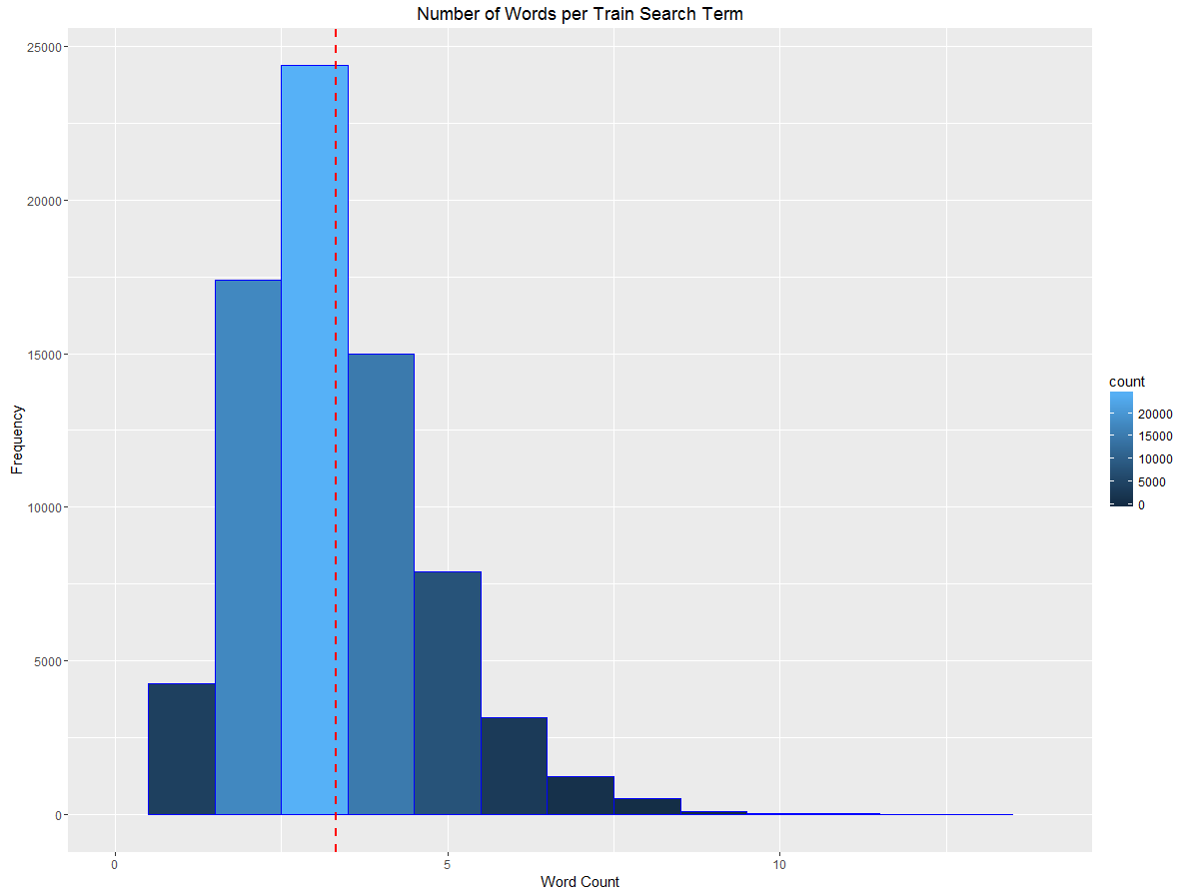
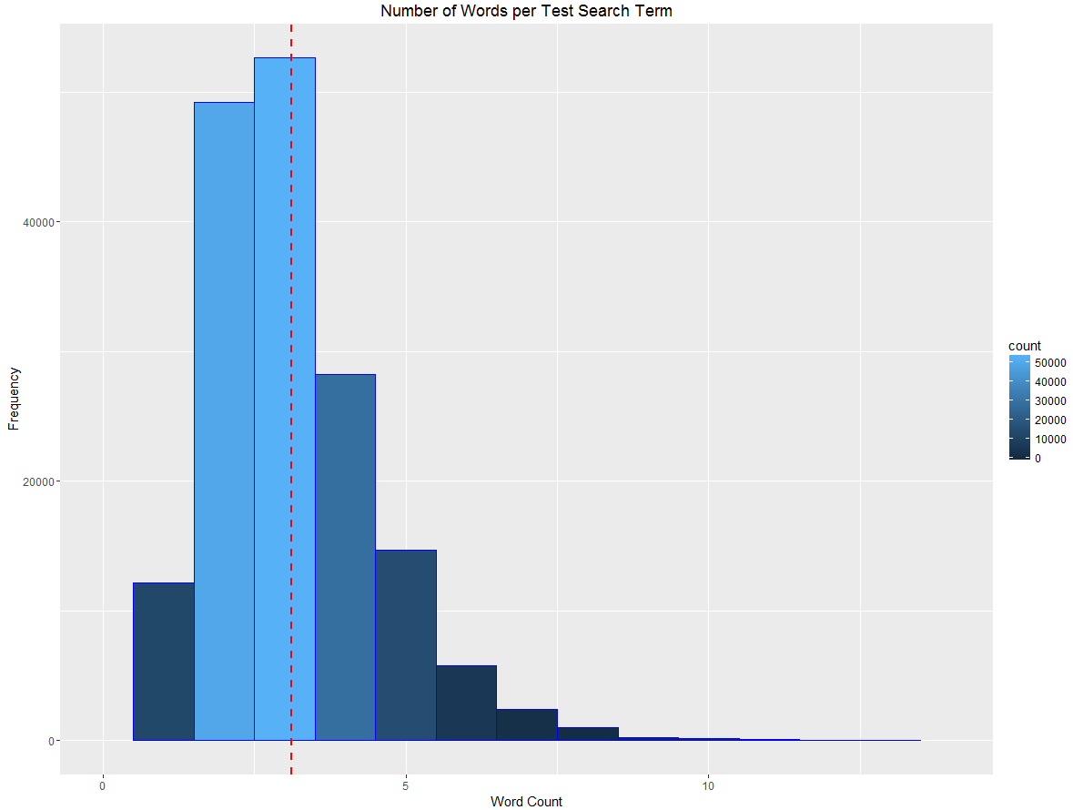
Data Processing
Show the frequency of the number of words per cleaned train and test search terms
Show that most search terms in both the train and test datasets have a word count of 5 or less
The mean for the train data is 3.317 and the mean for the test data is 3.12

Slide 7
Methods for Modeling Data
Our design to tackle this problem utilizes a methodology similar to the term frequency-inverse document frequency (tf-idf) calculation, which seeks to model how important a word is to a document in a collection
We calculate the proportion of words or numbers in the product brand name, title, and combined description and attributes (where applicable) that matched text in the search term
Use these proportions as predictors in machine learning regression models in order to predict relevance between search term and product pairs
Theoretically, if a large proportion of words or numbers in the product’s brand name, title, and/or description/attributes match text in the search term, the search result should be quite relevant and vice versa

Slide 8
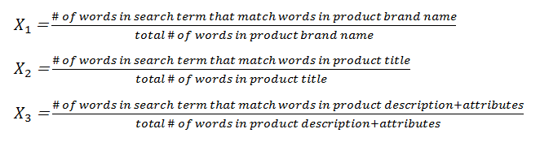
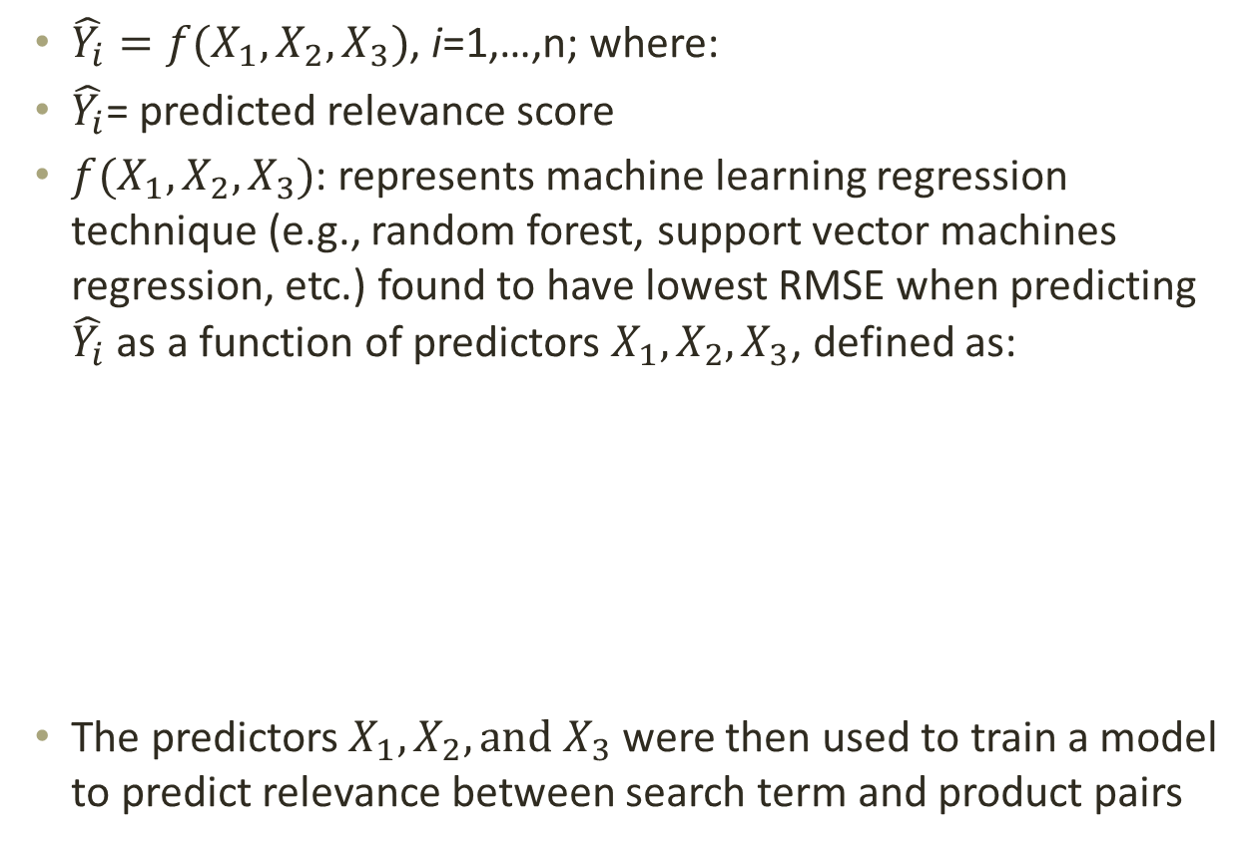
Methods for Modeling Data
$\hat{Y_{i}}=f(X_{1}, X_{2}, X_{3})$, i=1,…,n; where:
$\hat{Y_{i}}$= predicted relevance score
$f(X_{1}, X_{2}, X_{3})$: represents machine learning regression technique (e.g., random forest, support vector machines regression, etc.) found to have lowest RMSE when predicting $\hat{Y_{i}}$ as a function of predictors $X_{1}, X_{2}, X_{3}$, defined as:
The predictors $X_{1}, X_{2}, {and X}_{3}$ were then used to train a model to predict relevance between search term and product pairs

Slide 9
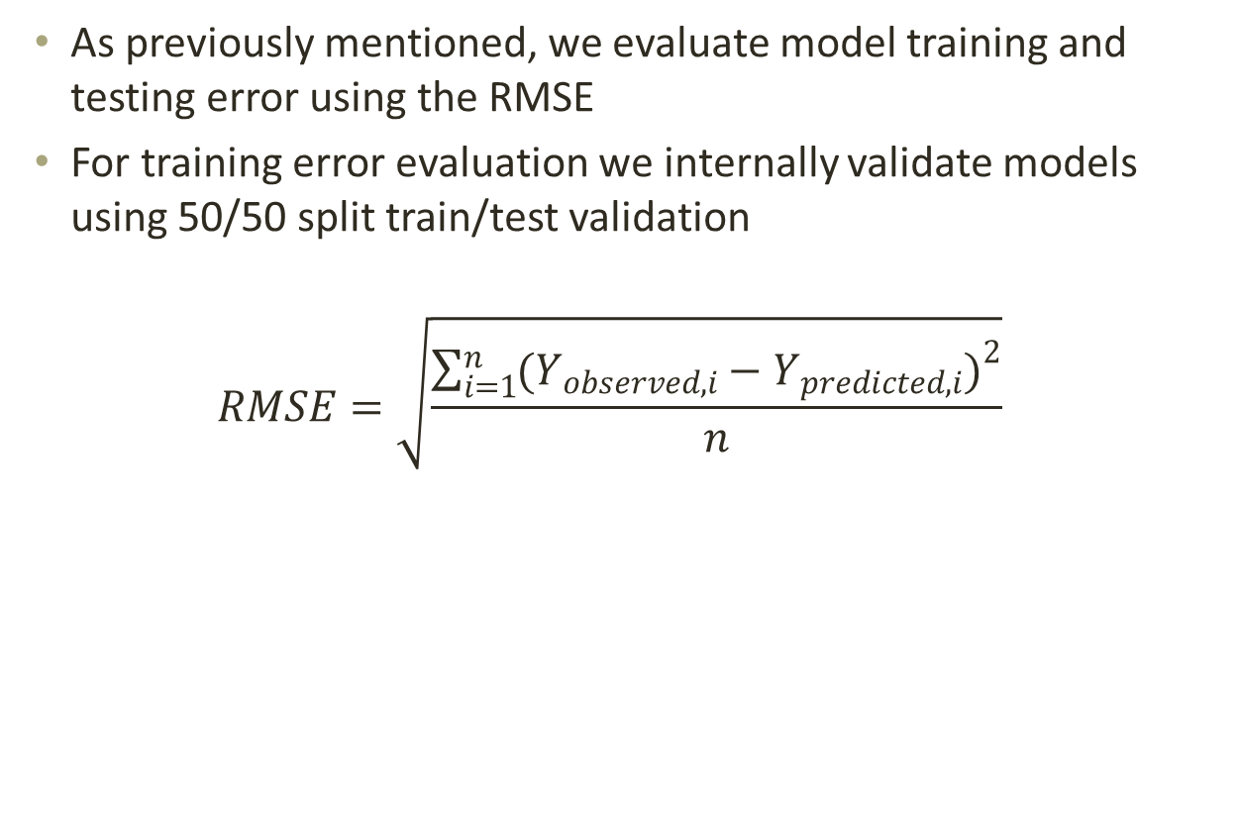
Methods for Modeling Data
As previously mentioned, we evaluate model training and testing error using the RMSE
For training error evaluation we internally validate models using 50/50 split train/test validation
$$RMSE=\sqrt{\frac{\sum_{i=1}^{n}{{(Y_{observed, i}−Y_{predicted, i})}^{2}}}{n}}$$

Slide 10
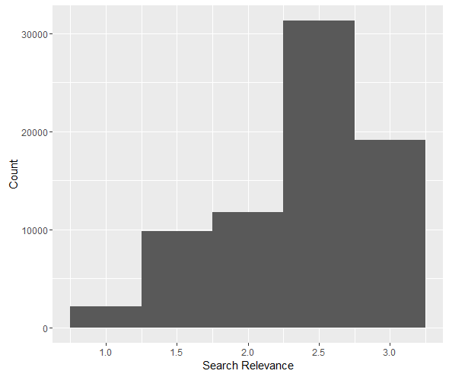
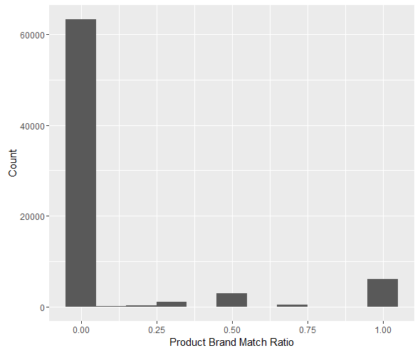
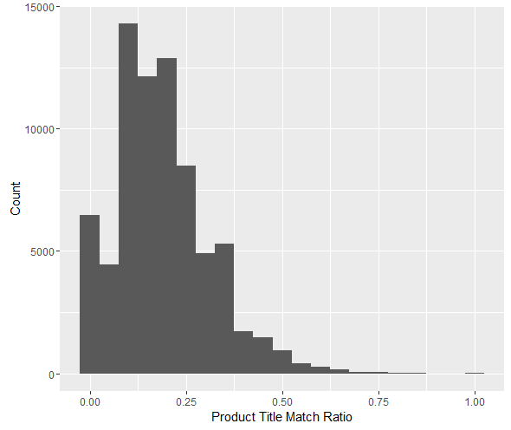
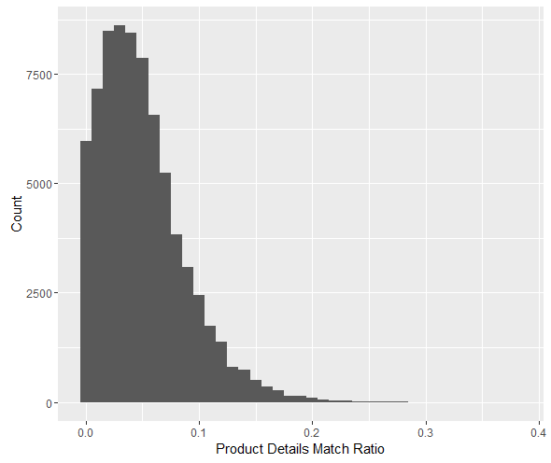
Results
We first present some histograms to assess the distributions of our outcome and predictor variables

Slide 11
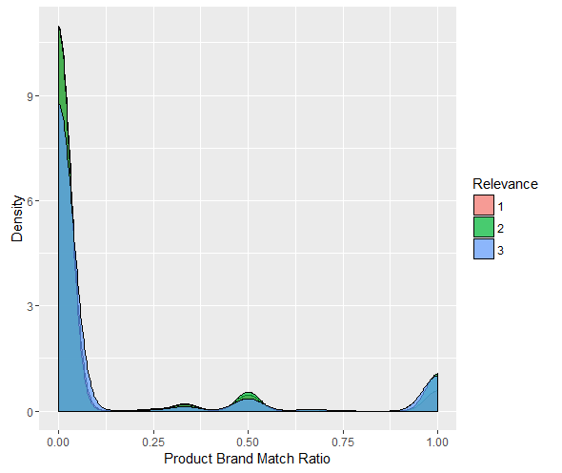
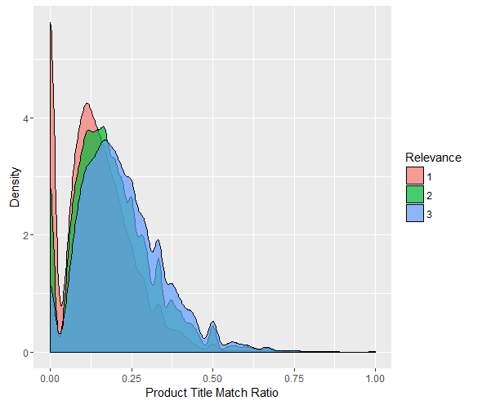
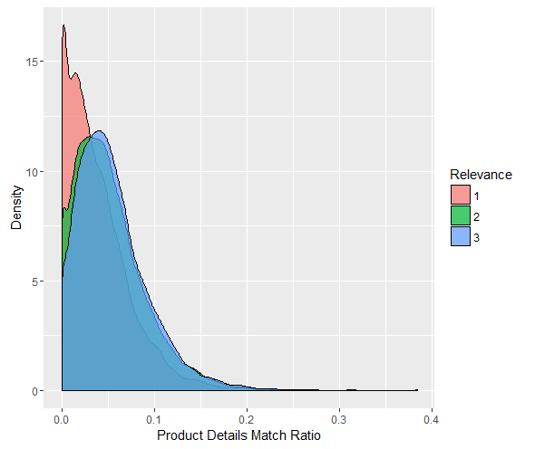
Results
We next present kernel density plots of each predictor conditional on rated search relevance score

Slide 12
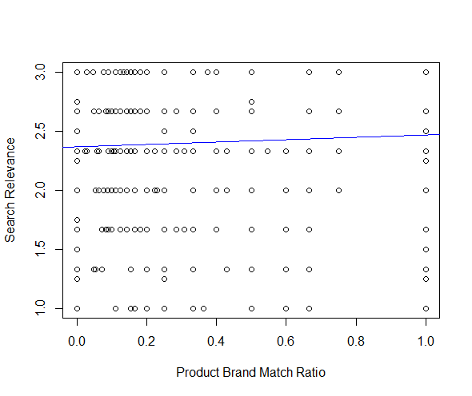
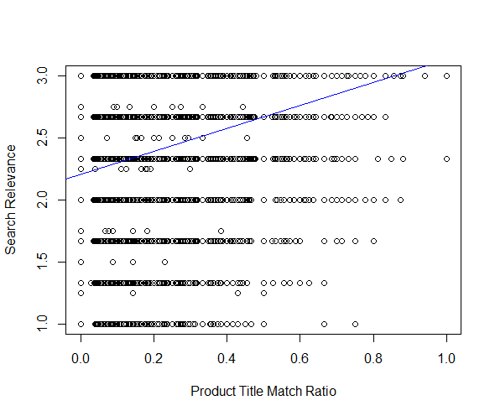
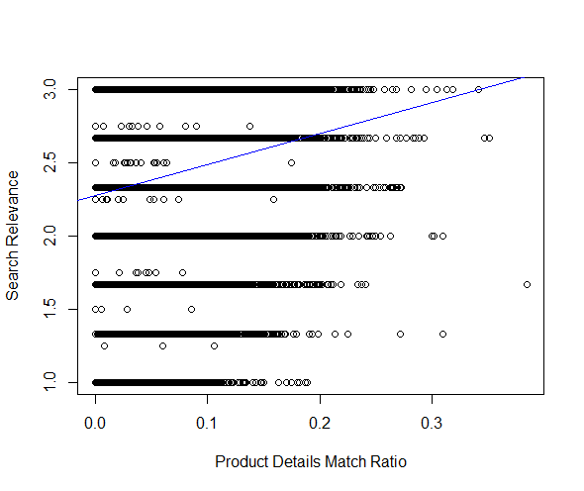
Results
As a final graphical assessment, we present scatter plots of rated search relevance versus each predictor match ratio along with line of best fit

Slide 13
Results
As a preliminary assessment of the strength of our predictors, we fit linear regressions of training set search relevance on each predictor first individually and then together in one multiple regression model.
Predictor | Coefficient | t-statistic | p-value
Product Brand Match Ratio | 0.10 | 14.84 | <2e-16
Product Title Match Ratio | 0.92 | 59.14 | <2e-16
Product Details Match Ratio | 2.12 | 41.43 | <2e-16
Product Brand Match Ratio | 0.84 | 14.25 | <2e-16
Product Title Match Ratio | 0.05 | 7.34 | 2e-13
Product Details Match Ratio | 0.77 | 41.57 | <2e-16

Slide 14
Results
Next we trained regression and machine learning models and calculated RMSEs using 50/50 split internal train/test validation
We then submitted the best fitting models on Kaggle and recorded the resulting RMSE for each.
Algorithm | Model Details | Train RMSE | Test RMSE
OLS Regression | Linear | 0.520 | 0.521
Random Forest | Number of Trees = 500 | 0.515 | 0.517
 | Number of Trees = 1000 | 0.515 | 0.517
Support Vector Machines Regression | Linear | 0.522 | 0.524
 | 2nd Order Polynomial | 0.531 | ---
 | 3rd Order Polynomial | 0.532 | ---
 | Radial | 0.520 | 0.522
Generalized Boosted Regression | Number of Trees = 500 | 0.530 | ---
 | Number of Trees = 1000 | 0.528 | 0.525

Slide 15
Conclusion
All three of our predictor match ratios were significant positive predictors of search relevance
Further transformation of predictor match ratios did not improve prediction
As compared to OLS, support vector machines, and generalized boosted regression techniques, random forest regression predicted with the lowest training and testing error

